Slide 1
Voice Based E-Mail For Blinds
Divanshu Aggarwal
Aviral
Diksha

Slide 2
Contents
Introduction
Project
Goals
Working
Tools
Design
Project description
Working principles
Project output
Future development
Limitations
References

Slide 3
Introduction
Email is one of the most important way of communication.
People who are not physically challenged they can use existing email system very efficiently but some people can not.
I developed a system that will help the physically challenged people to use mailing system efficiently.

Slide 4
Project Goals
Project goals Designing a voice mail system architecture that can be used by a physically challenged person to access mails easily and efficiently.
Thus reliance of physically challenged on other people for their activities related to mail can be reduced.
The main advantage of this system is that use of keyboard is completely eliminated, the user will have to respond through voice only.

Slide 5
Working Tools
Language
CSS3
Framework
REACT JS
NODE JS
Tools
VS CODE 2023
Database
POSTGRE SQL

Slide 6
Design
The design of this project is divided into three phases as described below:
Ul design- In this phase, the Ul or the user interface of the project is developed. That is, the designing of the web pages which the user will use to interact.
Database design- In our application, database is used to store user details such as name, age etc.
System design- In this phase, I developed the system completely with the help of all necessary elements.

Slide 7
Project Description
The Voice Based E-Mail System has following sections
They are:
Log In
Sign up
Menu
Listen
Compose
Sent
Inbox
Log Out

Slide 8
Project description (cont.)
Login:-
This is the very first page and will ask user to enter login credentials. After receiving all of the details from user, it will encrypt and check the validity of the details entered by user. If valid, then user will be redirected to dashboard else will be sent back to login page.
Dashboard:-
After successful login, user will be redirected to this page and this is the main page from where user can perform all the activities like, compose a new mail, check inbox, save to draft etc.

Slide 9
Project description (cont.)
Compose a Mail:-
This module is used to compose a new mail. Below are the steps followed by this module to compose a new mail:
Give voice data about the recipient, and cc, bcc, the subject and then the body.
Command send to send the mail or draft to save as draft of that mail.
Inbox:-
All the received mails will be listed sorted in order of date. Give voice input to filter mail, read out etc.

Slide 10
Project description (cont.)
Sent Mail:-
This module is used to Read sent mail. Below are the steps followed by this module to compose a new mail:
Give voice data about the number of the mail you want to listen.
Log Out:-
This module use to Exit from the system.

Slide 11
Key Words
The Voice Based E-Mail System has following Key words for perform the certain task
They are:
Log In
Create new account
Submit
Menu
Listen
Inbox
Sent
Correct
Log Out

Slide 12
Working principles(Cont.)
A java script voice library will guide the user throughout the process.
The mail composed by the user via voice will be converted to text before sending it to a normal individual.
Speech to text conversion.
Text to speech conversion.
Allowing auto correction of mail by reading it aloud before sending.
A handy device to carry out these operations.
SMTP has been used for mailing service.
IMAP used for transferring email from one end to another.

Slide 13
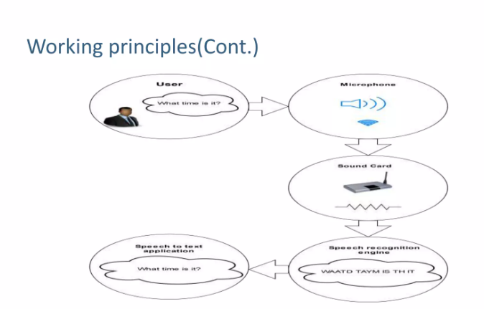
Working Principle(Cont.)
The Voice Based E-Mail System has following working mechanishm.
They are:

Slide 14
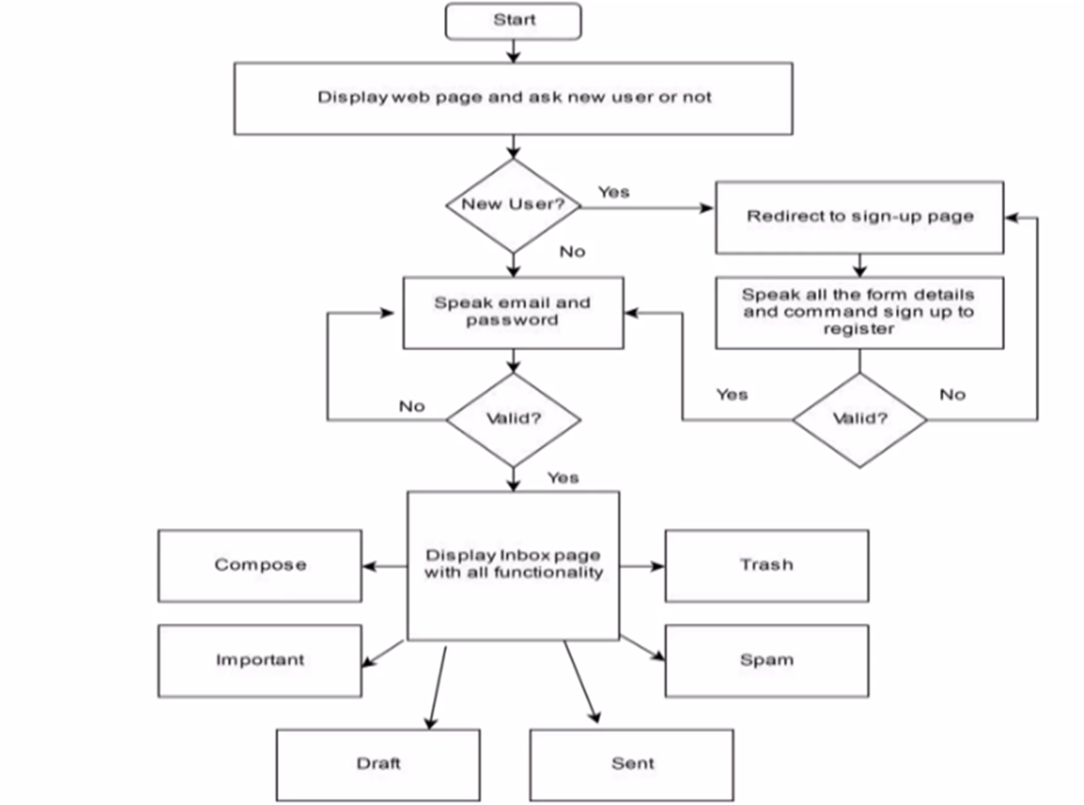
ER Diagram

Slide 15
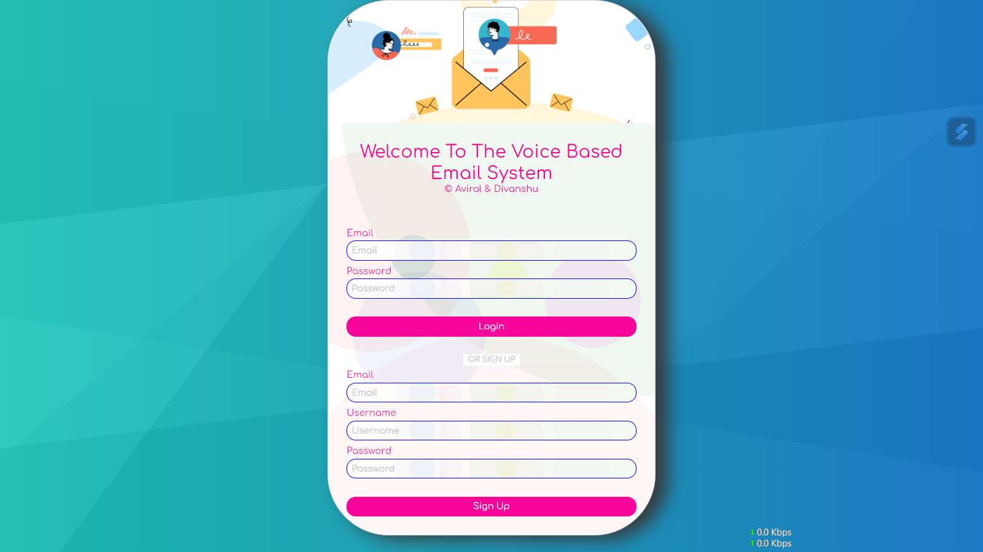
Project Output Log in/Sign up

Slide 16
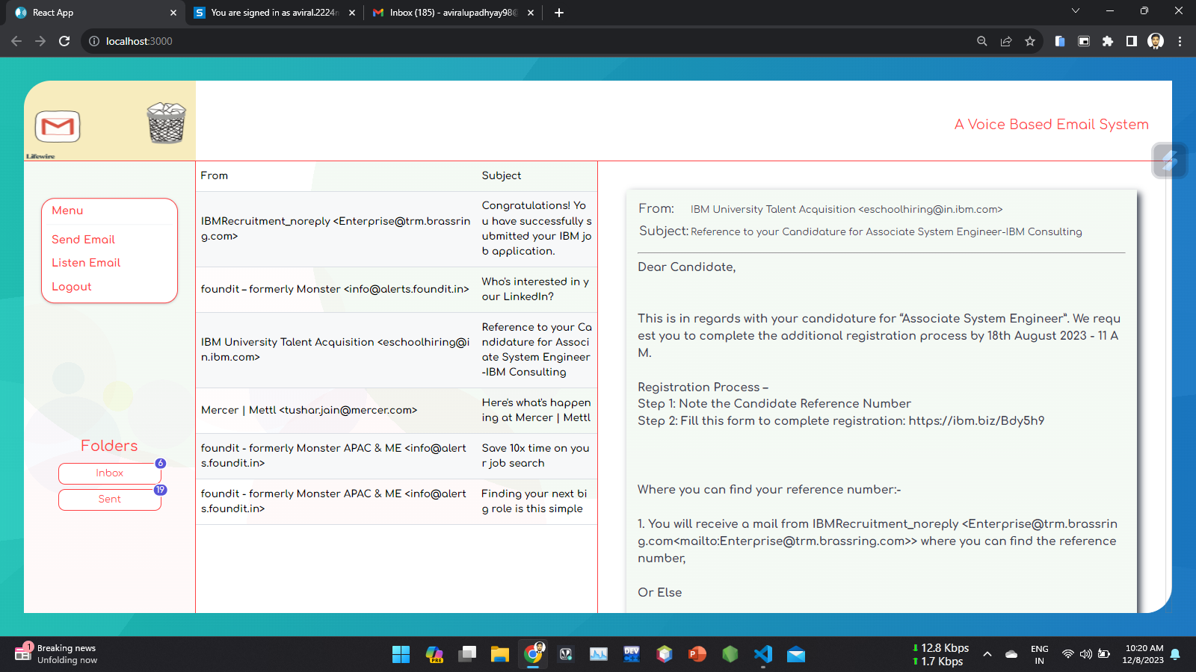
Project Output(Cont.) Inbox

Slide 17
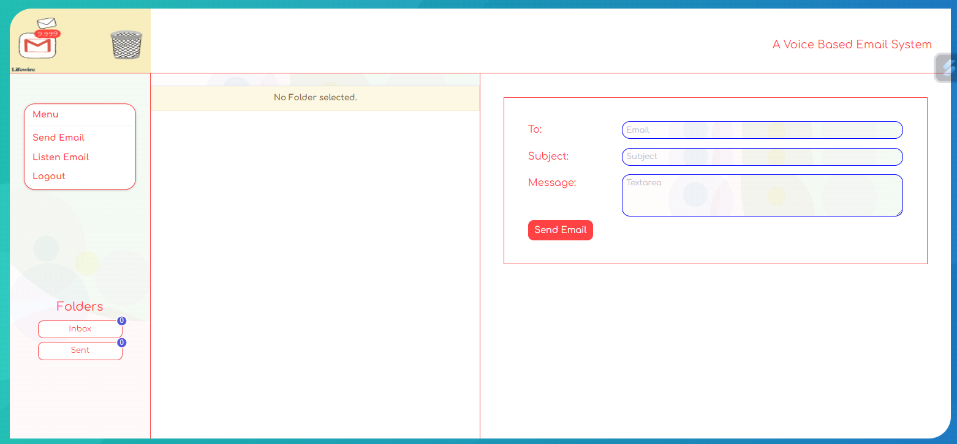
Project Output(Cont.) Compose Email

Slide 18
Future Scope
We have following Future Scops They are:
Future development Research on the features of the mailing system and add more.
Coding the all module to finished the development.
Testing and debugging.
Delivery and deployment of the project.

Slide 19
Limitations
There are some following limitations These are:
Limitations Need of high speed internet connection.
Need of noise free environment.
Need to correct pronunciation of sentence with clearly and loudly.

Slide 20
Thank you
Divanshu Aggarwal
Aviral
Diksha

